Slide 1
Sets, Maps and Graphs Traffic Flow
Use Map Canvas framework, Use Sets and Maps to design and build Graphs Implement Graph traversal and coloring algorithms.

Slide 2
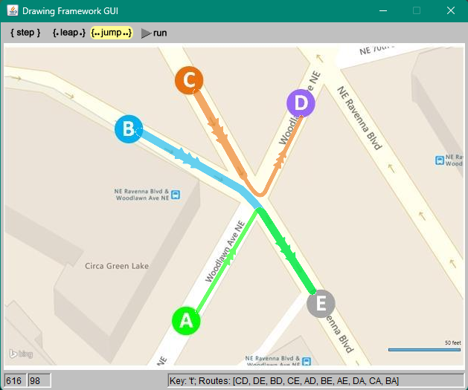
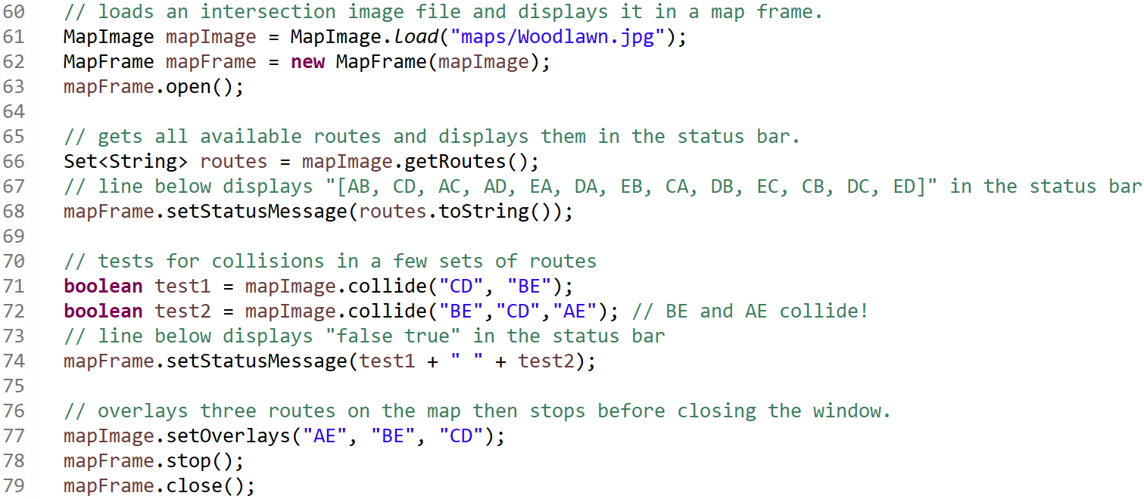
the Map Canvas framework
The MapCanvas will be used for labs accompanying several upcoming classes this semester. At high level, it provides the following functionality:
Loads a map of an intersection from an image file and displays it in a GUI window,
Provides means to interact with the map:
basic pan & zoom,
hook custom code on specific key press actions;
Provides metadata about the intersection:
available routes between locations around the intersection, as a set of two letter strings such as “AE”, “BE”, “CD”, … ,
collision test for two or more specific routes,
Gives the ability to overlay specific routes over the intersection map;
The framework comprises primarily of one class, MapCanvas. The library containing it is given within the startup project TrafficFlow_Startup.zip. Its capabilities are documented in the MapCanvas javadocs.
The map image displays the important locations around an intersection, labeled with single caps letters like ‘A’, ‘B’, ‘C’, ... Etc. The code below demonstrates most common usage of the MapFramework API:

Slide 3
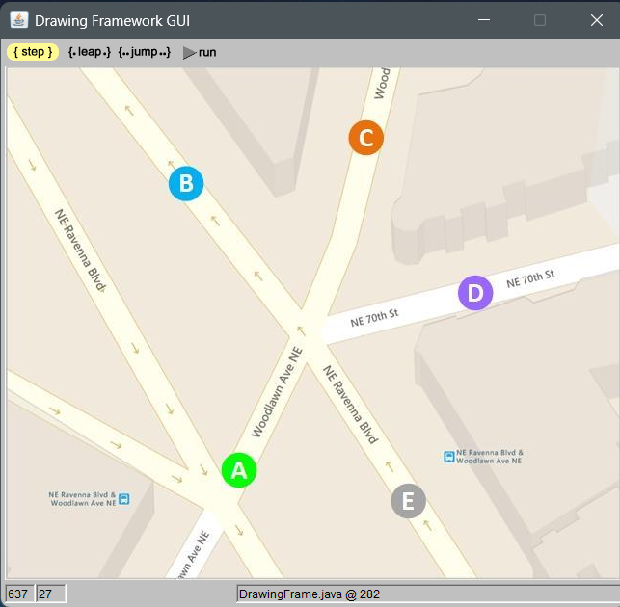
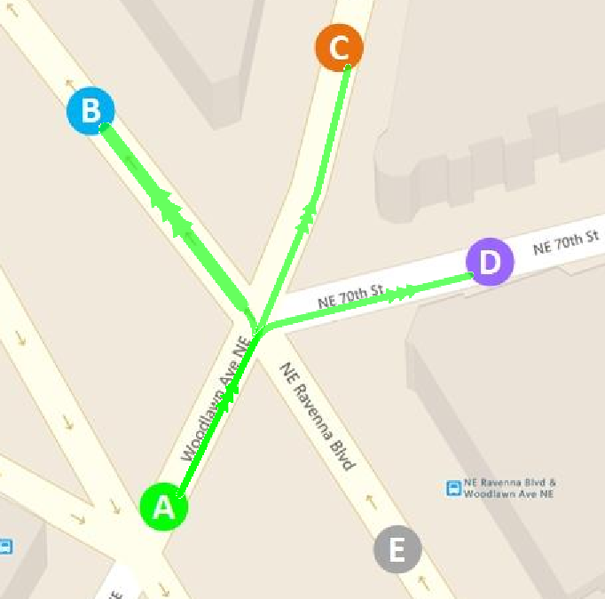
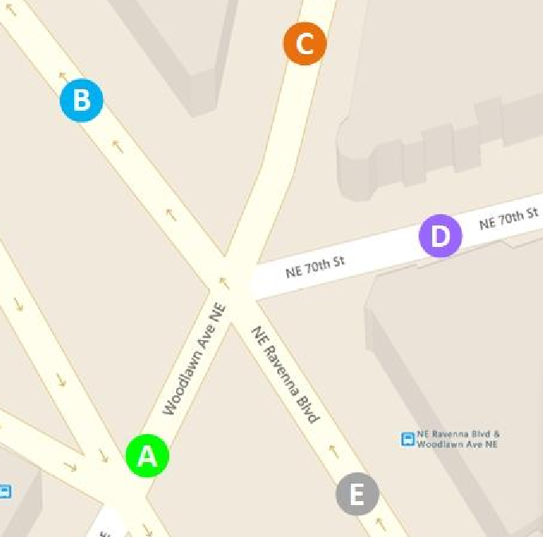
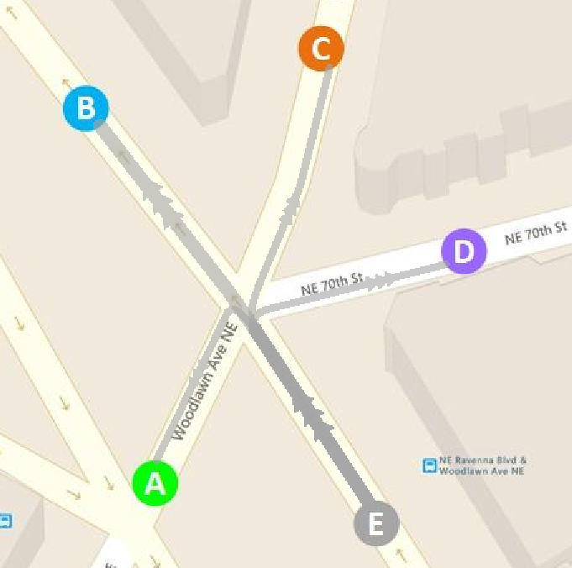



the Traffic Routes specification
In this lab you will build a program to determine all routes available from every location around a street intersection. The routes will be overlayed on the map when the user presses the key corresponding to each location. The names of the routes leading out from that location will be displayed in the status bar of the map window.
For example, consider the Ravenna intersection map included in the Startup project (maps/Ravenna.jpg). It embeds the following routes:
["AB", "CD", "AC", "AD", "EA", "DA", "EB", "CA", "DB", "EC", "CB", "DC", "ED"]
Given this map and routes, when your code is complete, it should behave as shown below: (Note: your program should work for other intersection maps in the project and for all the locations in those maps. The three cases below are given only as an example)
When the user types A the map shows: | When the user types B the map shows: | When the user types E the map shows:
E to B is a one-way street, you cannot reach E from any other location. | E to B is a one-way street, you cannot go from B to any other location
In addition, each time the user types a location, the status bar should display all possible routes which can be taken from that location to any other location.

Slide 4

the Traffic Routes hints
Think
 Code
At its core, what we need to do the following:
Create a mapCanvas and load it with an image of your choice from the ones provided: {“Ravenna.jpg”, “Woodlawn.jpg”, “Loyal.jpg”, “Sheridan.jpg”}
Read the list of routes available from _mapImage. They are given as a [Hash]Set of strings like in the example below:
["AB", "CD", "AC", "AD", "EA", "DA", "EB", "CA", "DB", "EC", "CB", "DC", "ED"]
Group (or bucketize) the routes based on their location of origin:
'A' → ["AB", "AC", "AD"] 'B' → [] 'C' → ["CD", "CA", "CB"] 'D' → ["DA", "DB", "DC"] 'E' → ["EA", "EB", "EC", "ED"]
This is a perfect application for a _locationsMap, with the single character as key and the set of related routes as value.
Ideally building this map is done in a different method and a unit test is added to verify it is working.
Register the _locationsMap keys 'A', 'B', 'C', 'D','E' the _mapFrame, such that custom code can run when the user presses any of these keys and do something akin to:
clear all overlays
clear the status bar text
if locationsMap contains the key that was typed then
get from locationsMap the set of routes associated with the key
overlay the set of routes on the map
endIf
reflect changes by repainting the map
Create a TrafficFlow folder in VSCode and copy into it the content of the TrafficFlow_Startup.zip given with this lab.
Run the program! A Drawing Framework GUI window comes up.
Press ‘T’ to print the routes in the status bar:
Press to advance the execution to the next breaking point.
Press the keys ‘A’, ‘B’, ‘C’, ‘D’ and ‘E’ to visualize (overlay) the routes.
Press the key ‘X’ to see in the status bar if they .
Review the structure of the project and read the code in Program.java.
Notice the _onKeyT class field. It is a lambda method: raw code referenced by a variable. Notice how it is used to register the code with the key ‘T’.
Review the MapCanvas javadocs to identify the calls for the functionality you need:
Getting the complete set of routes: MapCanvas.getRoutes();
Registering your code to be executed when user presses the key for any of the available locations: MapCanvas.setKeyHook();
Printing text in the status bar: MapCanvas.setStatusMessage();
Overlaying routes of your choice on the map: MapCanvas.setOverlays();
Finalize the code:
Write a method building a _locationsMap which maps each location to all routes connecting it to other locations.
Write a unit test method verifying the method’s behavior.
Write a lambda method and register it with all the location keys.
In it, identify the key being pressed (location that was selected) and overlay the routes mapped to that location.

Slide 5
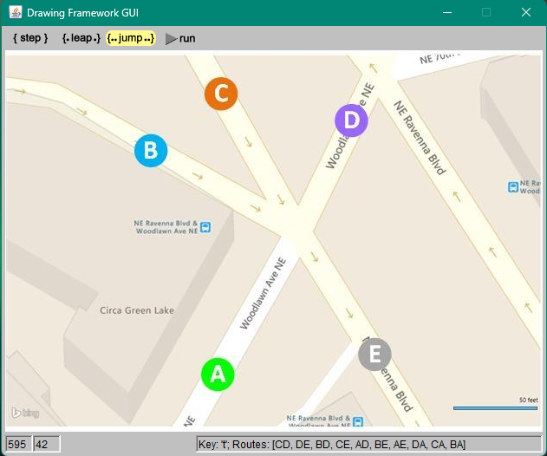
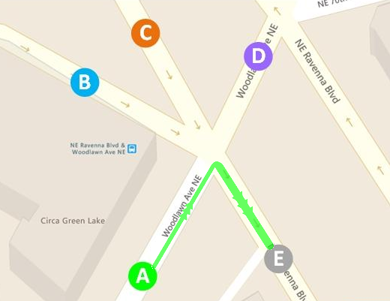
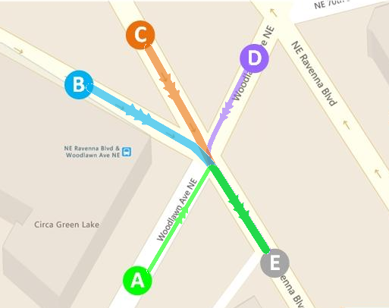

the Traffic Collisions specification
In this lab you will determine all routes colliding with every other route in a map and display them on the map in an interactive fashion. This information will be encoded in a graph, where each node represents a route on the map and any two colliding routes are linked by an edge. The following example shows a map with its collection of routes encoded in the associated collisions graph:
Note: If a route x collides with a route y, the opposite is also true: route y collides with the route x. In the Graph, this means if an edge links node x to node y, there is an edge linking node y to node x. Hence the Graph is undirected.
Building the graph can be coded in the main program, right after the MapImage object is loaded from its file. The MapCanvas javadocs provide methods for:
Getting all the routes available in the map image: | getRoutes()
Getting the routes currently overlaid on the map: | getOverlays()
Checking a given set of routes for collisions: | getCollision(routes)
Overlaying one or more routes on the map: | setOverlays(routes)
The Graph will be used to display the colliding routes on the map, in an interactive fashion:
When only route [AE] is displayed on the map… | … routes [DE, CE, BE] colliding with [AE] are also overlaid | … colliding routes are removed, only [AE] remains.
When the user presses the key 'X' do
if there is only one route overlaid on the map then
overlay the colliding routes
else if colliding routes are overlaid then
remove the colliding routes
endIf
endWhen
Press <X>
Press <X>

Slide 6
the Traffic Flow specification
In this final lab of this project, you will use the collisions graph built earlier to determine subsets of routes which do not collide with each other. Each of these subsets can thus represent a phase in the traffic flow through that intersection. Further, each of the subsets will be overlaid on the map in sequence, each time the user is pressing the key ‘W’.
Remember that each node in the graph represents a route, and each edge in the graph is linking routes which collide with each other. The algorithm for determining the non-colliding subsets of routes is then equivalent to solving what in graph theory is called a graph-coloring problem:
A graph coloring algorithm is a way of labeling (or “coloring”) the nodes of a graph such that no two adjacent nodes have the same label (or “color”).
When the algorithm completes, all nodes having the same label represent a subset of non colliding routes, hence a phase in the traffic flow. The count of labels generated by the algorithm represent the number of phases in the traffic flow through that intersection. All what’s left is the UI for overlaying them in succession, similar to what’s been done in the previous lab.
Following is a pseudo code of the graph-coloring algorithm followed by an exemplification of how it works on the graph from the previous lab:
graphColoring()
0. Place all nodes in the graph, initially unlabeled, in an unlabeledQueue.
Start with an initial label value (say 1)
Use a greedy() method to apply the label to a subset of non-adjacent nodes from the unlabeledQueue thus removing them from the queue
Increment label
Repeat steps 2 and 3 until all nodes are labeled and the unlabeledQueue becomes empty.
greedy(label, unlabeledQueue)
0. Start with an empty labeledSet.
for each node in the unlabeledQueue do
if no otherNode from the labeledSet is connected to node then
mark node with the label
move node from the unlabeledQueue to the labeledSet
endIf
endFor
unlabeledQueue: [AD BD CA AE CD BA DA CE BE DE]
unlabeledQueue: [BD CA CD DA CE BE DE]
unlabeledQueue: [CA CD DA CE DE]
unlabeledQueue: [DA DE]
label_1: [AD AE BA]
label_2: [BD BE]
label_3: [CA CD CE]
label_4: [DA DE]

